Slide 1
Classes and Functions in PHP
CS/IT 490 WD, Fall 2013

Slide 2
Functions
We can create our own functions in PHP.
These can be inside of a class, or outside of one.
No return-type specified, just start with function.

Slide 3
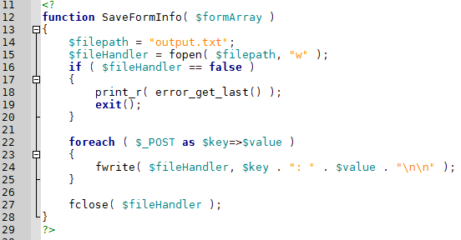

Functions
Function Definition:
Function Call:

Slide 4
Functions
Functions can have parameters – remember to begin variable names with $
Arguments are passed by value automatically, but you can pass them by reference.
Functions can be overloaded

Slide 5
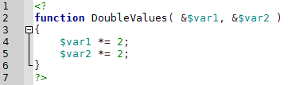

Functions
Passing an argument by-reference:
These parameters have an ampersand before the $variablename
No special characters on the arguments themselves.

Slide 6
Classes
Classes can contain functions and variables
Classes can have constructors & destructors
We can create static members / functions
Classes can inherit from other classes
We can have abstract classes (think of virtual and pure virtual functions in C++)

Slide 7
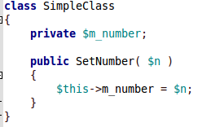
Classes - Members
You can create member functions and member variables, along with accessibility in PHP.
Notice that accessing member variables requires
$this->varname

Slide 8
Classes – Constructors & Destructors
The old way of creating constructors was to make a function with the class name.
However, there is a new way to handle constructors.

Slide 9
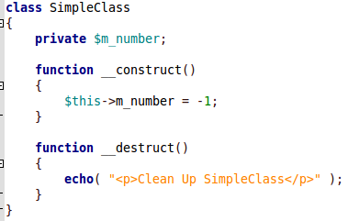
Classes – Constructors & Destructors

Slide 10
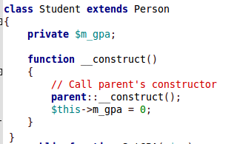
Classes – Constructors & Destructors
For a child class, you can call its parent's constructor with:
parent::__construct();

Slide 11
Classes – Constructors & Destructors
You cannot overload constructors
Constructors CAN have arguments
How can you get around inability to overload constructors?

Slide 12
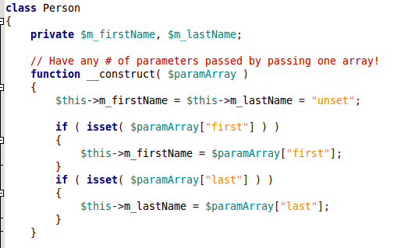

Classes – Variable Parameters
You can create a function with a variable number of parameters with an associative array!

Slide 13

Classes - Instantiation
Create a new instance of a class like this:
To access members of a class, you must use the -> operator

Slide 14
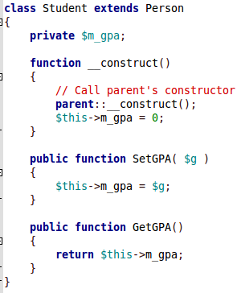
Classes – Inheritance & Composition
A class can inherit from another using the extends keyword:

Slide 15
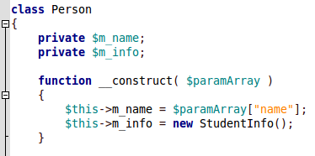
Classes – Inheritance & Composition
Composition is simply having one class as a member variable of another class
This will be a class instantiation
Class is instantiated here

Slide 16
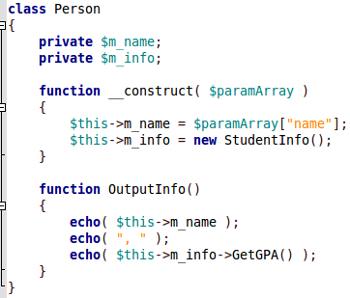
Classes – Inheritance & Composition
Composition is simply having one class as a member variable of another class
We can access members of the composed class with
$this->varname->membername

Slide 17
Classes – Static Members

Slide 18
Classes - Abstraction

Slide 19
References
-

